Slide 1

BCS2313: Artificial Intelligence Techniques
Module 1.2:
Agent

Slide 2

Learning Objectives
Intelligent Agents
Agent Function & Program
Structure of agents
Types of agent programs

Slide 3
Intelligent Agents

Slide 4


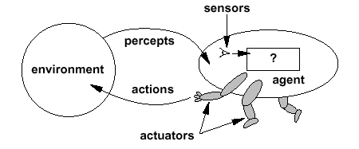
Intelligent Agents
An agent is anything that perceiving its environment through sensors and acting upon that environment through actuators
What is an agent?

Slide 5

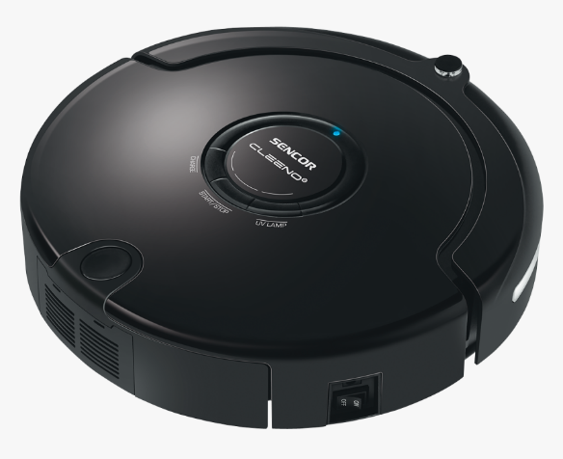

Examples:
Human is an agent. Has eyes, ears and other organs for sensors and hands, legs, vocal tract and so on as actuators
A robot is also an agent with cameras and infrared range finders for sensors and various motors for actuators
A software agent receives keystrokes, file contents, and network packets as sensory inputs and acts on the environment by displaying on the screen, writing files, and sending network packets.

Slide 6
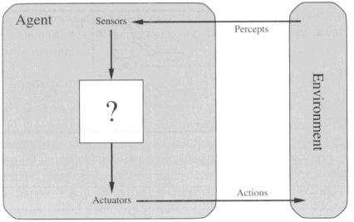
Diagram of an agent
What AI should fill
Agents interact with environments through sensors and actuators.

Slide 7
Terms in agent
Percept
Agent’s percept sequence
The agent’s perceptual inputs at any given instant
The complete history of everything the agent has ever perceived
In general, an agent’s choice of action at any given instant can depend on the entire percept sequence observed to date, but not on anything it hasn’t perceived.

Slide 8
Agent function & program
Agent’s behavior is mathematically described by
Agent function
A function mapping any given percept sequence to an action
Practically it is described by
An agent program
The real implementation
The agent function is an abstract mathematical description
The agent program is a concrete implementation, running within some physical system.

Slide 9
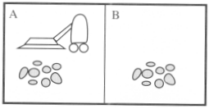
Eg: Vacuum Cleaner World
The vacuum agent perceives which square it is in and whether there is dirt in the square. It can choose to move left, move right, suck up the dirt, or do nothing.
Locations: squares A and B
Perception: Clean or Dirty? where it is in?
Actions: Move left, Move right, suck, do nothing
Agent function: if the current square is dirty, then suck; otherwise, move to the other square.

Slide 10
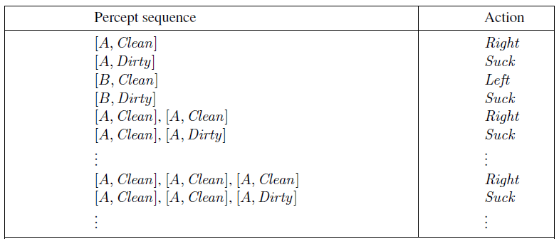
Eg: Vacuum Cleaner World
Partial tabulation of a simple agent function for the vacuum-cleaner world
Function Reflex-Vacuum-Agent([location,status]) return an action
If status = Dirty then return Suck
else if location = A then return Right
else if location = B then return left
Program

Slide 11
Good behaviour: The concept of rationality
A rational agent is one that does the right thing-conceptually speaking, every entry in the table for the agent function is filled out correctly.
By considering the consequences of the agent’s behaviour.
When an agent is plunked down in an environment, it generates a sequence of actions according to the percepts it receives.
What does it mean to do the right thing?
This sequence of actions causes the environment to go through a sequence of states. If the sequence is desirable, then the agent has performed well.
This notion of desirability is captured by a performance measure that evaluates any given sequence of environment states.

Slide 12
Good behaviour: The concept of rationality
What is rational at any given time depends on FOUR (4) things:
The performance measure that defines the criterion of success.
The agent’s prior knowledge of the environment
The actions that the agent can perform
The agent’s percept sequence to date

Slide 13
Good behaviour: The concept of rationality
This leads to a definition of a rational agent:
For each possible percept sequence, a rational agent should select an action that is expected to maximize its performance measure, given the evidence provided by the percept sequence and whatever built-in knowledge the agent has.

Slide 14


Task Environment (PEAS)
Performance, Environment, Actuators, Sensors
In designing an agent, the first step must always be to specify the task environment as fully as possible.
Agent Type: Taxi Driver
Performance Measure: Safe, fast, legal, comfortable trip, maximize profits
Environment: Roads, other traffic, pedestrians, customers
Actuators: Steering, accelerator, brake, signal, horn, display
Sensors: Cameras, speedometer, GPS, engine sensors
Imagine a softbot Web site operator designed to scan Internet news sources and show the interesting items to its users, while selling advertising space to generate revenue.
Performance Measure: ?
Environment: ?
Actuators: ?
Sensors: ?
What about software agent/softbot?

Slide 15
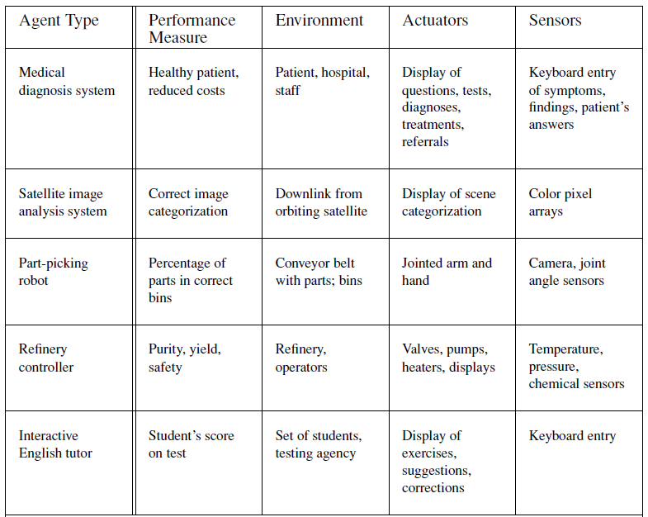

Slide 16
The nature of environments
Fully observable vs. partially observable:
If an agent’s sensors give it access to the complete state of the environment at each point in time, then we say that the task environment is fully observable.
A task environment is effectively fully observable if the sensors detect all aspects that are relevant to the choice of action; relevance, in turn, depends on the performance measure.
Fully observable environments are convenient because the agent need not maintain any internal state to keep track of the world.
An environment might be partially observable because of noisy and inaccurate sensors or because parts of the state are simply missing from the sensor data—for example, a vacuum agent with only a local dirt sensor cannot tell whether there is dirt in other squares, and an automated taxi cannot see what other drivers are thinking.
If the agent has no sensors at all then the environment is un-observable.

Slide 17



The nature of environments
Single agent vs. multiagent: The distinction between single-agent and multiagent environments may seem simple enough.
How to determine multiagent? First, we have described how an entity may be viewed as an agent, but we have not explained which entities must be viewed as agents.
In the taxi-driving environment, on the other hand, avoiding collisions maximizes the performance measure of all agents, so it is a partially cooperative multiagent environment. It is also partially competitive because, for example, only one car can occupy a parking space.
In chess, the opponent entity B is trying to maximize its performance measure, which, by the rules of chess, minimizes agent A’s performance measure. Thus, chess is a competitive multiagent environment.

Slide 18
The nature of environments
Deterministic vs. stochastic:
If the next state of the environment is completely determined by the current state and the action executed by the agent, then we say the environment is deterministic; otherwise, it is stochastic.
In principle, an agent need not worry about uncertainty in a fully observable, deterministic environment.
(In our definition, we ignore uncertainty that arises purely from the actions of other agents in a multiagent environment; thus, a game can be deterministic even though each agent may be unable to predict the actions of the others.)
If the environment is partially observable, however, then it could appear to be stochastic.
Most real situations are so complex that it is impossible to keep track of all the unobserved aspects; for practical purposes, they must be treated as stochastic.
Taxi driving is clearly stochastic in this sense, because one can never predict the behavior of traffic exactly; moreover, one’s tires blow out and one’s engine seizes up without warning.

Slide 19
The nature of environments
Episodic vs. sequential:
In an episodic task environment, the agent’s experience is divided into atomic episodes.
In each episode the agent receives a percept and then performs a single action. Crucially, the next episode does not depend on the actions taken in previous episodes.
Many classification tasks are episodic. For example, an agent that has to spot defective parts on an assembly line bases each decision on the current part, regardless of previous decisions; moreover, the current decision doesn’t affect whether the next part is defective.
In sequential environments, on the other hand, the current decision could affect all future decisions.
Chess and taxi driving are sequential: in both cases, short-term actions can have long-term consequences.
Episodic environments are much simpler than sequential environments because the agent does not need to think ahead.

Slide 20
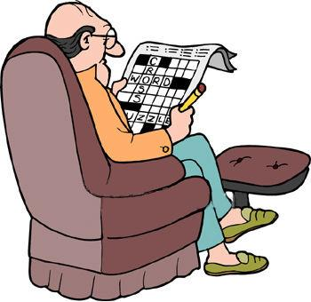
The nature of environments
Static vs. dynamic:
If the environment can change while an agent is deliberating, then we say the environment is dynamic for that agent; otherwise, it is static.
Static environments are easy to deal with because the agent need not keep looking at the world while it is deciding on an action, nor need it worry about the passage of time.
Dynamic environments, on the other hand, are continuously asking the agent what it wants to do; if it hasn’t decided yet, that counts as deciding to do nothing.
If the environment itself does not change with the passage of time but the agent’s performance score does, then we say the environment is semi-dynamic.
Taxi driving is clearly dynamic: the other cars and the taxi itself keep moving while the driving algorithm dithers about what to do next.
Chess, when played with a clock, is semi-dynamic. Crossword puzzles are static.

Slide 21
The nature of environments
Discrete vs. continuous: The discrete/continuous distinction applies to the state of the environment, to the way time is handled, and to the percepts and actions of the agent.
For example, the chess environment has a finite number of distinct states (excluding the clock).
Chess also has a discrete set of percepts and actions.
Taxi driving is a continuous-state and continuous-time problem: the speed and location of the taxi and of the other vehicles sweep through a range of continuous values and do so smoothly over time.
Taxi-driving actions are also continuous (steering angles, etc.).
Input from digital cameras is discrete, strictly speaking, but is typically treated as representing continuously varying intensities and locations.

Slide 22
The nature of environments
Known vs. unknown:
Strictly speaking, this distinction refers not to the environment itself but to the agent’s (or designer’s) state of knowledge about the “laws of physics” of the environment.
In a known environment, the outcomes (or outcome probabilities if the environment is stochastic) for all actions are given.
Obviously, if the environment is unknown, the agent will have to learn how it works in order to make good decisions.
Note that the distinction between known and unknown environments is not the same as the one between fully and partially observable environments.
It is quite possible for a known environment to be partially observable—for example, in solitaire card games, I know the rules but am still unable to see the cards that have not yet been turned over.
Conversely, an unknown environment can be fully observable—in a new video game, the screen may show the entire game state but I still don’t know what the buttons do until I try them.

Slide 23
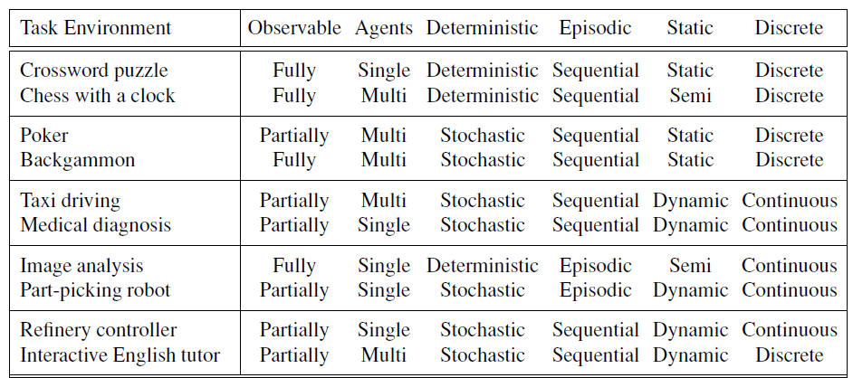
Examples of nature environments and their characteristics

Slide 24
The Structure Of Agents

Slide 25

The Structure Of Agents
Agent = architecture + program
Architecture = some sort of computing device (sensors + actuators)
(Agent) Program = some function that implements the agent mapping = “?”
Agent Program = Job of AI

Slide 26

Agent Program
Input for Agent Program
Only the current percept
Input for Agent Function
The entire percept sequence
The agent must remember all of them
Implement the agent program as
A look up table (agent function)

Slide 27
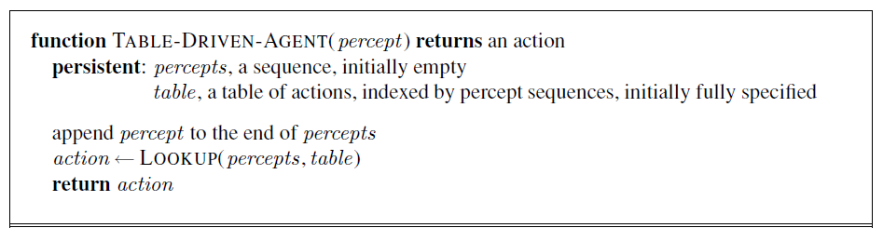
Skeleton design of an agent program
Despite of huge size, look up table does what we want.
The key challenge of AI
Find out how to write programs that, to the extent possible, produce rational behavior
From a small amount of code
Rather than a large amount of table entries
E.g., a five-line program of Newton’s Method vs huge tables of square roots, sine, cosine, …

Slide 28
Types of Agent Programs

Slide 29

Types of Agent Programs
How many types of agent programs?

Slide 30

Types of Agent Programs
Simple Reflex Agents
Model-based Reflex Agents
Goal-based Agents
Utility-based Agents
Learning Agents

Slide 31
Simple Reflex Agents

Slide 32
Simple Reflex Agents
These agents select actions on the basis the current percept, ignoring the rest of the percept history.
It uses just condition-action rules
The rules are like the form “if … then …”
efficient but have narrow range of applicability
Because knowledge sometimes cannot be stated explicitly
Work only
if the environment is fully observable

Slide 33
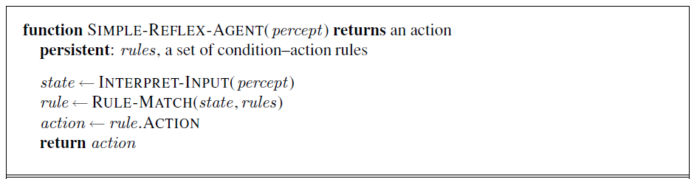
Simple Reflex Agents
Agent acts according to a rule whose condition matches the current state, as defined by the percept.

Slide 34
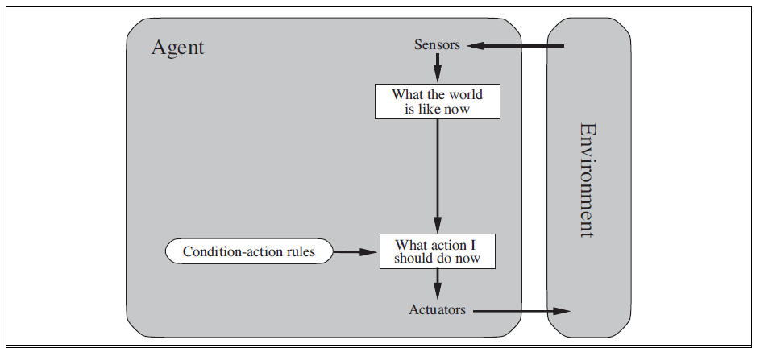
Simple Reflex Agents

Slide 35
Simple Reflex Agents
RULES:
(1) If small moving object,
then activate SNAP
(2) If large moving object,
then activate AVOID and inhibit SNAP
ELSE (not moving) then NOOP
needed for
completeness
Action: SNAP or AVOID or NOOP

Slide 36
Model-based Reflex Agents

Slide 37
Model-based Reflex Agents
For the world that is partially observable the agent has to keep track of an internal state
That depends on the percept history
Reflecting some of the unobserved aspects
E.g., driving a car and changing lane
Requiring two types of knowledge
How the world evolves independently of the agent
How the agent’s actions affect the world

Slide 38
Example Table Agent With Internal State
IF
THEN
Saw an object ahead, and turned right, and it’s now clear ahead | Go straight
Saw an object Ahead, turned right, and object ahead again | Halt
See no objects ahead | Go straight
See an object ahead | Turn randomly

Slide 39
Example Reflex Agent With Internal State: Wall-Following
start
Actions: left, right, straight, open-door
Rules:
If open(left) & open(right) and open(straight) then
choose randomly between right and left
If wall(left) and open(right) and open(straight) then straight
If wall(right) and open(left) and open(straight) then straight
If wall(right) and open(left) and wall(straight) then left
If wall(left) and open(right) and wall(straight) then right
If wall(left) and door(right) and wall(straight) then open-door
If wall(right) and wall(left) and open(straight) then straight.
(Default) Move randomly

Slide 40
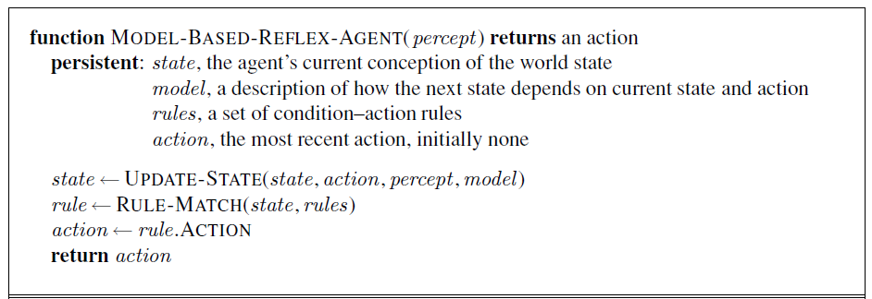
Model-based Reflex Agents
The agent is with memory

Slide 41
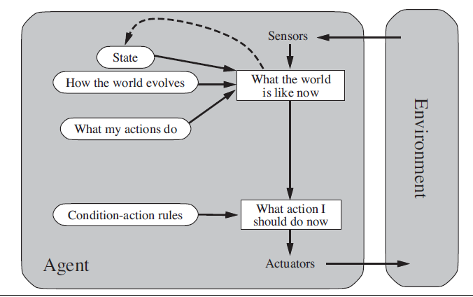
Model-based Reflex Agents

Slide 42
Goal Based Agents

Slide 43
Goal Based Agents
Current state of the environment is always not enough
The goal is another issue to achieve
Judgment of rationality / correctness
Actions chosen → goals, based on
the current state
the current percept
Conclusion
Goal-based agents are less efficient
but more flexible
Agent ← Different goals ← different tasks
Search and planning
two other sub-fields in AI
to find out the action sequences to achieve its goal

Slide 44
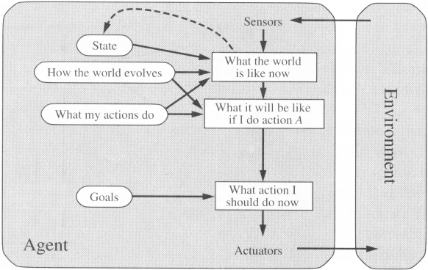
Goal Based Agents

Slide 45
Utility-Based Agents

Slide 46
Utility-Based Agents
Goals alone are not enough
to generate high-quality behavior
E.g. meals in Canteen, good or not ?
Many action sequences → the goals
some are better and some worse
If goal means success,
then utility means the degree of success (how successful it is)
it is said state A has higher utility
If state A is more preferred than others
Utility is therefore a function
that maps a state onto a real number
the degree of success
Utility has several advantages:
When there are conflicting goals,
Only some of the goals but not all can be achieved
utility describes the appropriate trade-off
When there are several goals
None of them are achieved certainly
utility provides a way for the decision-making

Slide 47
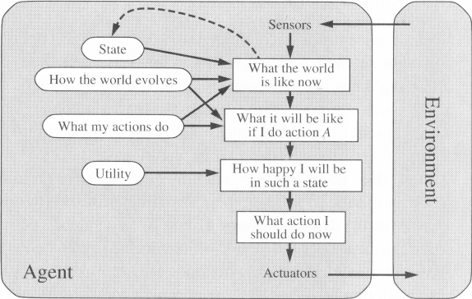
Utility-Based Agents

Slide 48
Learning Agents

Slide 49
Learning Agents
After an agent is programmed, can it work immediately?
No, it still need teaching
In AI,
Once an agent is done
We teach it by giving it a set of examples
Test it by using another set of examples
We then say the agent learns
A learning agent
Four conceptual components
Learning element
Making improvement
Performance element
Selecting external actions
Critic
Tells the Learning element how well the agent is doing with respect to fixed performance standard. (Feedback from user or examples, good or not?)
Problem generator
Suggest actions that will lead to new and informative experiences.

Slide 50
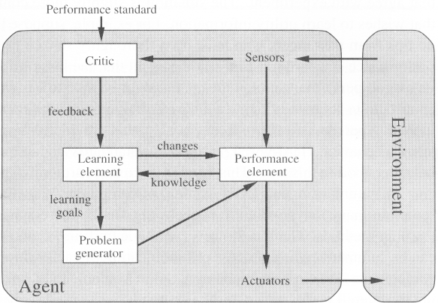
Learning Agents

Slide 51

51

